Slide 1
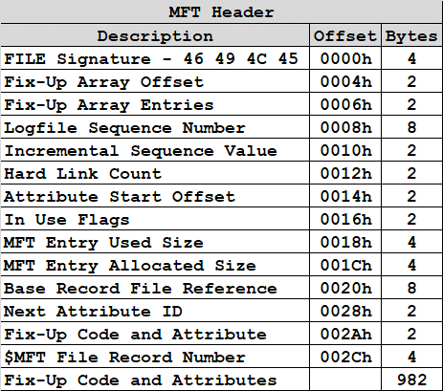
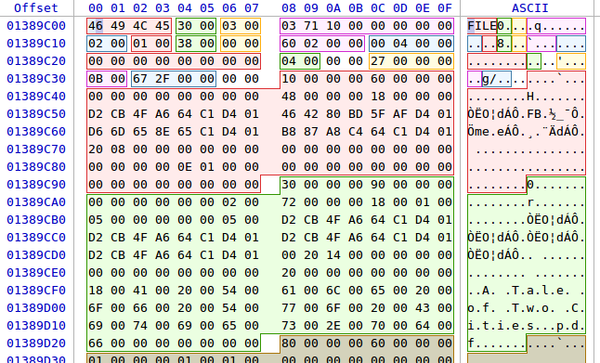
NTFS – In Use Flags – Deleted File

Slide 2
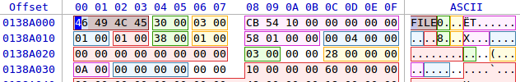
NTFS – In Use Flags – Active File

Slide 3
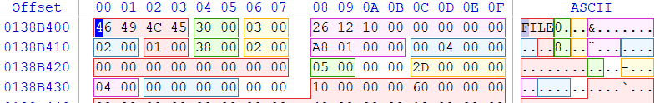
NTFS – In Use Flags – Deleted Folder

Slide 4
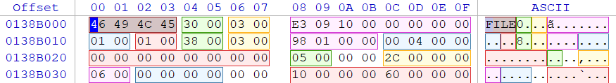
NTFS – In Use Flags – Active Folder

